Slide 1

Comparison of Established Parallelization Frameworks for Training Various ML Models on ECG Data
Taylor
Taylor Hartman, Kendra Givens, Scott Hartsell
Kendra
Notes:
Taylor

Slide 2
Research Goals
Compare parallel processing frameworks on speed to complete training ML models
Compare prebuilt ML models on accuracy
Kendra
Scott
Notes:
Scott

Slide 3
Motivations
Familiarize ourselves with:
Parallelization frameworks
Machine Learning (ML) Classification Models
PySpark
Data processing
ML library (MLlib)
Learn the best parallel processing techniques for big data
Scott
Taylor
Notes:
Kendra

Slide 4
Introduction
Notes:
Scott

Slide 5
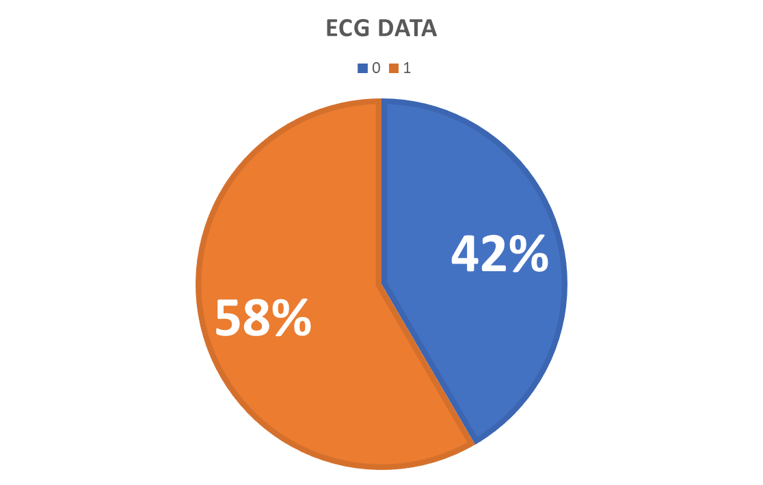
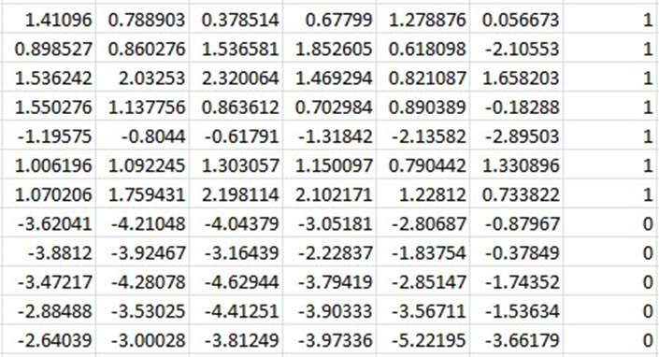

Dataset
Unaltered data obtained from Kaggle [1]
Heart rate tracking & monitoring
Labels represent normal/abnormal patterns
4998 rows with 140 feature columns
1 label column
Taylor
Kendra
Notes:
Scott

Slide 6



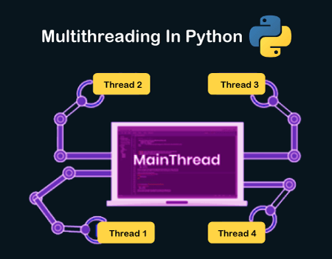


Technologies Used
Kendra
Taylor
Notes:
Kendra

Slide 7
Background
Notes:
Taylor

Slide 8
Apache Spark
Apache Spark 100 times faster than Apache Hadoop MapReduce
Actions take place in cache memory
Apache Spark performs “lazy operations”
Actions take place after the transformation phase of the Extract Transform and Load (ETL) pipeline
Apache Spark overall is faster computationally and uses less memory performing actions compared to Apache Hadoop [1]
Taylor
Taylor
Notes:
Taylor

Slide 9
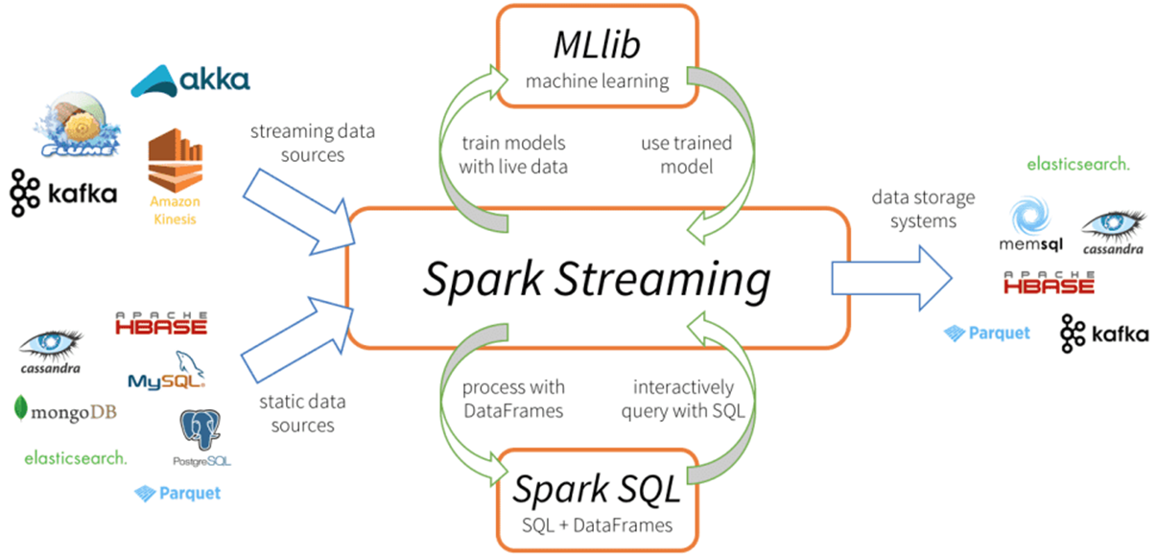
Apache Spark
Taylor
Taylor
Notes:
Taylor

Slide 10
Machine Learning Models
Logistic Regression
Support Vector Classifier
Random Forest
Taylor
Taylor
Notes:
Taylor

Slide 11
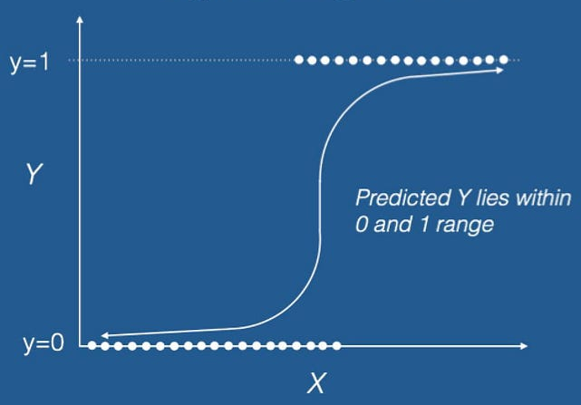
Logistic Regression
Taylor
Taylor
Notes:
Taylor

Slide 12
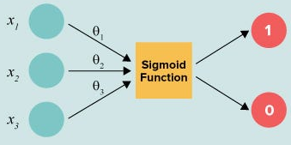

Logistic Regression
Taylor
Taylor
Notes:
Taylor

Slide 13
Support Vector Classifier
Finds best plane to split the classes of data
If the data is not easy to separate, can transform data into a higher dimension for more accurate classification
Works well on small datasets, but can become slow with larger data
Kendra
Kendra
Notes:
Kendra

Slide 14

Support Vector Classifier
Kendra
Scott
Notes:
Kendra

Slide 15
Random Forest
Scott
Create specified range of decision trees, each with a unique dataset
“bootstrapping”: partition of original, with allowed duplicate samples
Random features used to make decisions at each branch, with Information Gain
Each tree outputs a classification from a unique viewpoint
The forest “votes”, and majority rules for final classification output
Scott
Notes:
Scott

Slide 16
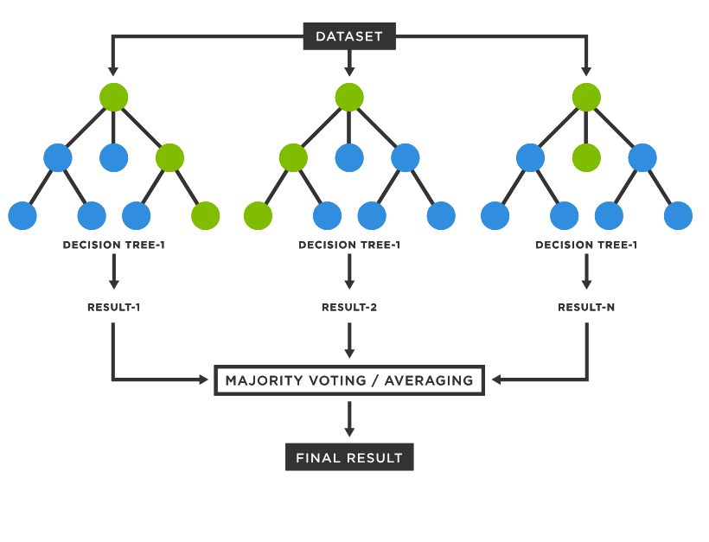
Random Forest
Scott
Information Gain
IG(Y,X) = E(Y) - E(Y|X)
Taylor
Notes:
Scott

Slide 17
Parallelization Frameworks
Python Threads
MPI
Taylor
Taylor
Notes:
Scott

Slide 18
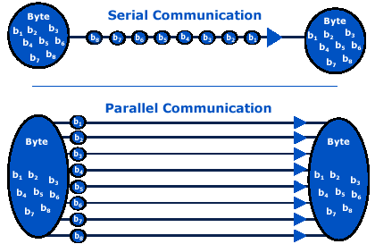
Serial Control
To evaluate the performance of our parallelization frameworks, we compared against a serial baseline
Taylor
Kendra
Notes:
Taylor

Slide 19
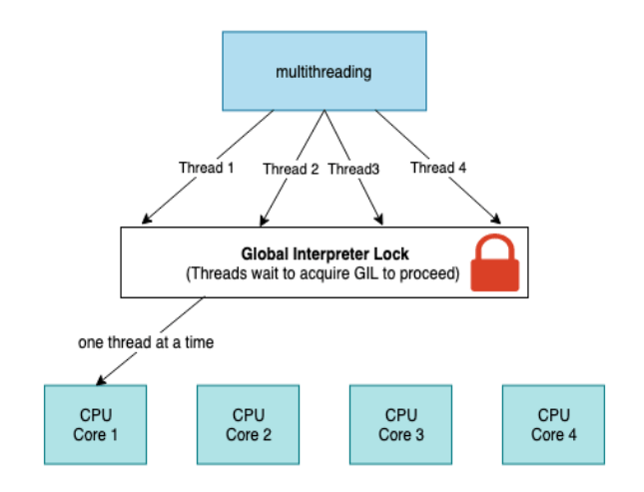
Python Threads
Lightweight process
Shares the same memory space
Threads have to trade off on global interpreter lock(GIL) access which prevents true parallelism (GIL gone in Python 3.12)
Kendra
Scott
Notes:
Taylor

Slide 20
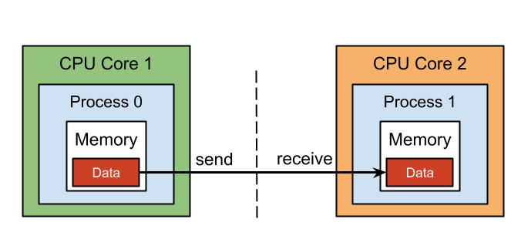
MPI
MPI (Message Passing Interface) is used in distributed memory architectures where each process has its own memory
Communication can be blocking or non-blocking
Scott
Taylor
Notes:
Taylor

Slide 21
Methods
Notes:
Taylor

Slide 22
Preprocessing Data
Balance dataset
Separate features from labels
Standardize data with mean and standard deviation
Transform data to vector
Group data by feature and vector
Split data into train, test, validation
70/20/10
Taylor
Taylor
Notes:
Taylor

Slide 23
Dataset Refresher
Unaltered data obtained from Kaggle [1]
Heart rate tracking & monitoring
Labels represent normal/abnormal patterns
4998 rows with 140 feature columns
1 label column
Taylor
Taylor
Notes:
Scott

Slide 24
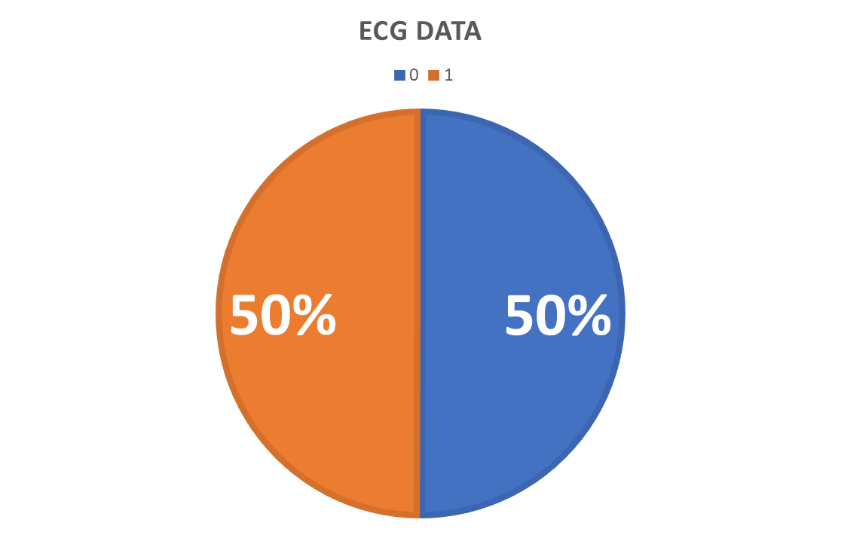
Preprocessing Data
Preprocessed using Spark
844 Rows with label of 1 removed to equalize
Used .randomSplit() with a seed to keep 2075
Still:
4154 rows with 140 feature columns
1 label column
Taylor
df = spark.read.csv("ecg.csv", header=False, inferSchema=True)
df = df.withColumnRenamed(df.columns[-1], "label")
df2 = df.filter(df['label'] == '1')
df = df.filter(df['label'] == '0')
df3, df4 = df2.randomSplit([0.30, 0.70], seed=1000)
df = df.union(df4)
del df2
del df3
del df4
gc.collect()
Scott
Notes:
Taylor

Slide 25
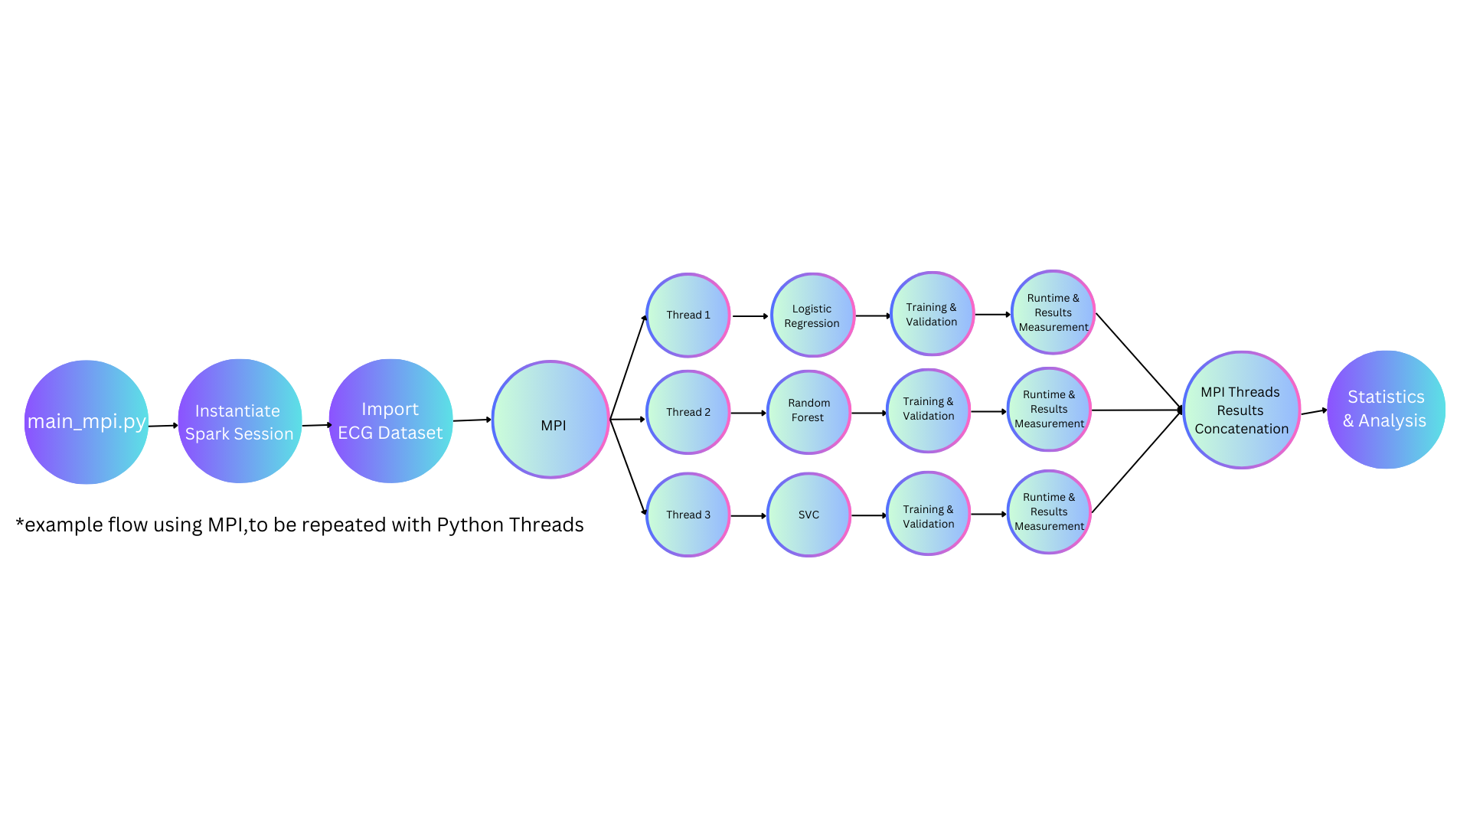
Experiment Framework
Scott
Kendra
Notes:
Scott

Slide 26
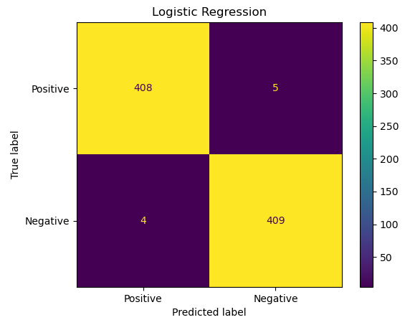
Evaluation
Run each 100 times and average the accuracies of validation data
Create confusion matrix of predictions for each ML model to compare accuracy
Compare computation speed for each parallel framework
Kendra
Summary Stats
Validation Accuracy = 0.9891
Taylor
Notes:
Kendra

Slide 27
Results
Notes:
Taylor

Slide 28
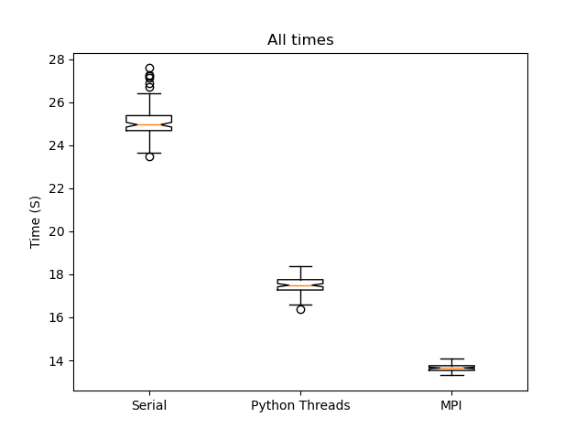
Parallelization Time Results
MPI had the best performance
Taylor
Scott
Notes:
Kendra

Slide 29
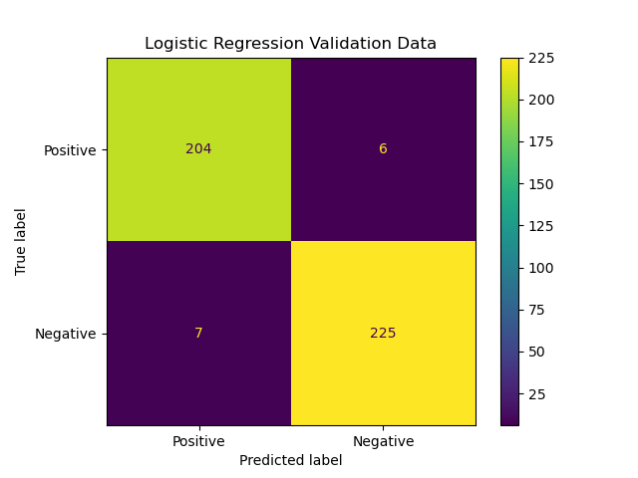
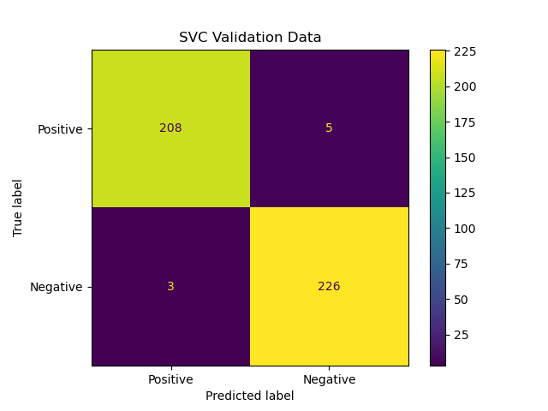

Model Confusion Matrices
Scott
Kendra
Notes:
Kendra

Slide 30
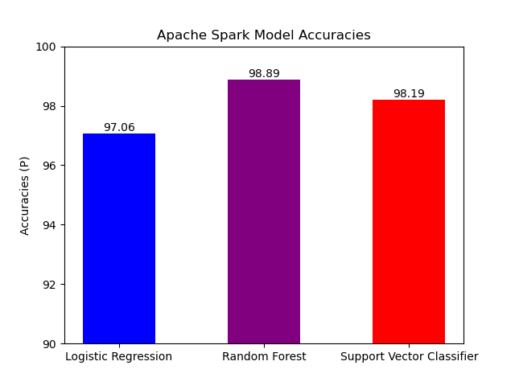
Model Accuracy Results
Random Forest has the best performance
Kendra
Taylor
Notes:
Kendra

Slide 40
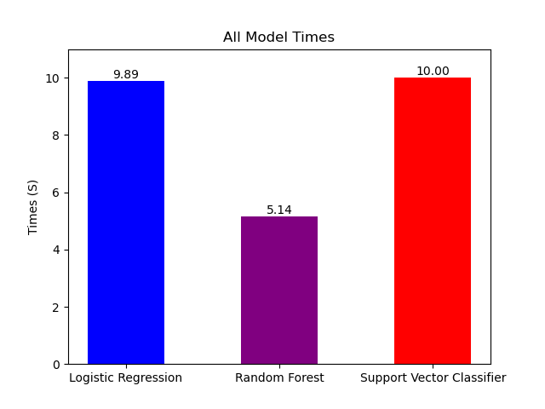
Model Times Results
Random Forest has the best performance
Taylor
Taylor
Notes:
Kendra

Slide 41
Discussion
Notes:
Kendra

Slide 42
Impacts
MPI proved to be the fastest
Python Threads more readable
Should be used instead of Serial or Python Threads
Trade off between performance (speed) and code readability
MPI executes in true parallel
Threads uses shared processing power; GIL
Random Forest fastest to train and most accurate
Taylor
Taylor
Notes:
Kendra

Slide 43
Future Research
Testing on a larger dataset
Comparing more algorithms and frameworks
Comparing the memory usage of each framework
Comparing Python Threads without GIL to the other frameworks
Taylor
Demo
Notes:
Kendra

Slide 44
Code Demo
Notes:
Kendra

Slide 45
Questions?
Notes:
Kendra

